Slide 1
Big Data Marketing Workshop
Getting the Customer Insight
Using “R”
Prof. Taewan Kim
tkim21@konkuk.ac.kr

Slide 2
Prof. Taewan Kim 김태완 교수
Research Interests
신제품 개발
  제품 시연, 자동차 산업, 영화, 계량 모델
가격이론
  동태적 가격 이론, 제품 위치선정 전략, 요금제도,
  분석적 모델, 게임이론
Taewan Kim and Tridib Mazumdar, Product Concept Demonstrations in Trade Shows and Firm Value, Journal of Marketing, July 2016, Vol. 80, No. 4, pp. 90-108

Slide 3
Prof. Taewan Kim 김태완 교수
Teaching Interests
마케팅 전략 (박사)
마케팅 조사 방법론 (박사)
경영통계론 (MBA)
마케팅 조사론 (MBA)
Big Data Marketing Analytics (학부)
마케팅 전략 (학부)

Slide 4
Agenda
What is Big Data?
How can we collect Big Data?
  rvest.R
  Toolkit: SelectorGadget.com
  Exercise: alexa.r
Text-mining
  tm.R
  Big Data Visualization
Managerial implications
Good example

Slide 5
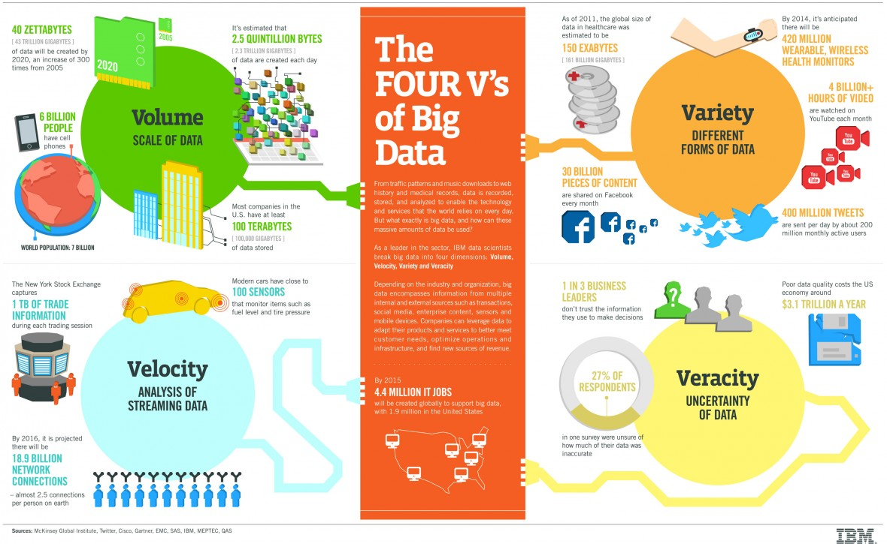

Slide 6
R 설치하기
Download R: https://cloud.r-project.org/
Download R 4.1.2 for Windows (86 megabytes, 32/64 bit)
Online resources (Feel free to utilize as much as you wish)
    RStudio: https://www.rstudio.com/products/rstudio/download/
    Data Camp: https://www.datacamp.com/courses/free-introduction-to-r
    ‘An Introduction to R’ would be good starting point.
    Manuals: https://cran.r-project.org/manuals.html

Slide 7
Rvest.R
You need to install an extra gadget: http://selectorgadget.com/
Data scraping: http://blog.rstudio.org/2014/11/24/rvest-easy-web-scraping-with-r/
  Alexa example (for, rbind, cbind): alexa.R
  html ‘rvest’: https://cran.r-project.org/web/packages/rvest/rvest.pdf
  Tutorial rvest: http://stat4701.github.io/edav/2015/04/02/rvest_tutorial/
  Formatting data into table: https://cran.r-project.org/web/packages/data.table/vignettes/datatable-intro.pdf
  Scraping an HTML Table using rvest: http://www.r-bloggers.com/using-rvest-to-scrape-an-html-table/

Slide 8
echoshow10.r
library(rvest)
library(RCurl)

Slide 9
echoshow10.r
# 1. Install two packages
#install.packages('rvest')
#install.packages('RCurl')
library(rvest)
library(RCurl)

Slide 10
echoshow10.r
# 2. Identify the web address
# search product - click reviews - sort by recent
# remove the page number at the end of the URL
url <- "https://www.amazon.com/All-new-Echo-Dot-3rd-Gen/product-reviews/B0792KTHKJ/ref=cm_cr_arp_d_viewopt_srt?ie=UTF8&reviewerType=all_reviews&sortBy=recent&pageNumber="
#url <- " your url "

Slide 11
echoshow10.r
# 3. Specify how many pages you would like to scrape
N_pages <- 3
# It would be easier to test with small number of pages and it depends on your own source website

Slide 12
echoshow10.r
A <- NULL
for (j in 1: N_pages){
echoshow <- read_html(paste0(url, j))
#help paste: http://www.cookbook-r.com/Strings/Creating_strings_from_variables/
B <- cbind(ipad %>%
html_nodes(".review-text") %>%
html_text(), echoshow10 %>%
html_nodes("#cm_cr-review_list .review-date") %>%
html_text() )
# I replaced html_nodes for review date with "#cm_cr-review_list .review-date"
# "#cm_cr-review_list" makes two irrelevant parts for the top positive/critical reviews and '#'is the magic sign for unselect the part
A <- rbind(A,B)
}

Slide 13
echoshow10.r
# 4. Make sure what you got
print(j)
# This command shows the progress of the for loop. This example it means number of pages.
# 4.1 Another way to double-check
tail(A,10) #데이터의 마지막 10개를 출력
# 5. Save the output
write.csv(data.frame(A),"echoshow10.csv")

Slide 14
tm.R
Open this script file

Slide 15
#1. Installing relevant packages
Needed <- c("tm", "SnowballCC", "RColorBrewer", "ggplot2", "wordcloud", "biclust", "cluster", "igraph", "fpc")
install.packages(Needed, dependencies = TRUE)
  # 지우고 위에 세 줄을 하이라이트 하고 돌리세요
install.packages("Rcampdf", repos = "http://datacube.wu.ac.at/", type = "source")
  # 지우고 위에 세 줄을 하이라이트 하고 돌리세요

Slide 16
#2. Loading texts
Save the collected data as CSV file
Move it into “texts” folder on the desktop
Change the code with your updated folder location
Normally, you computer might have different folder location from the example code

Slide 17
#2.1 Change Folder and Directory
cname <- file.path("C:/Users/user/Desktop", "texts")
# This part should be revised by your own location of your texts folder.
# Please make sure you exchange \ with /. Make sure you are using /.
Also change your working directory

Slide 18
#3. Generating a Corpus
# 3.0 Generating a Corpus, one document data set
data <- read.csv(“echoshow10.csv") #change the name of the file
data<-data[,2]
head(data)
docs <- Corpus(VectorSource(data))
#summary(docs)

Slide 19
#3.1 Preprocessing 전처리
# 3.1 Preprocessing ==parsing
docs <- tm_map(docs,removePunctuation)
docs <- tm_map(docs, removeNumbers)
docs <- tm_map(docs, tolower)
docs <- tm_map(docs, removeWords, stopwords("english"))
docs <- tm_map(docs, removeWords, c("echo","show")) # you can add more irrelevant words hear!
docs <- tm_map(docs, stripWhitespace)

Slide 20
#3.4 Word Frequency table
### 3.4 Plot Word Frequencies
library(ggplot2)
wf <- data.frame(word=names(freq), freq=freq)
p <- ggplot(subset(wf, freq>200), aes(x = reorder(word, -freq), y = freq))
# Plot words that appear at least 200 times; You can modify this
p <- p + geom_bar(stat="identity")+ theme(axis.text.x=element_text(angle=45, hjust=1))
p

Slide 22
#3.5 Word Association
### 3.5 Term Correlations
# If words always appear together, then correlation=1.0.
findAssocs(dtms, "great", corlimit=0.1) # specifying a correlation limit of 0.1
findAssocs(dtms, "quality", corlimit=0.1) # specifying a correlation limit of 0.1
findAssocs(dtms, "camera", corlimit=0.1) # specifying a correlation limit of 0.1

Slide 23
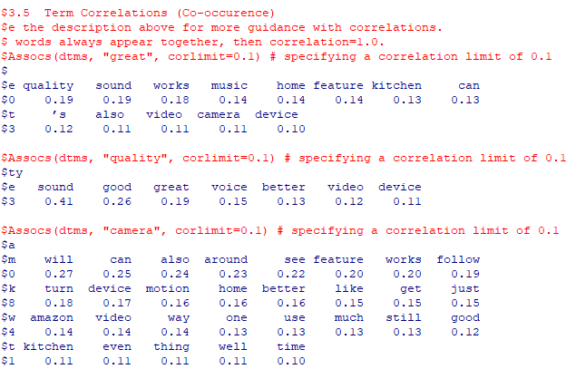

Slide 24
Word Association
장점
  단어끼리의 연결고리를 파악
  짐작이 가는 내용을 확인
단점
  어떤 단어부터 시작 해야 할 지 막막함
  해결책: clustering 결과에서 clue를 활용

Slide 25
#4. Word Clouds
library(wordcloud) # First load the package that makes word clouds in R
dtms <- removeSparseTerms(dtm, 0.9)
# Prepare the data (max 10% empty space)
freq <- colSums(as.matrix(dtm)) # Find word frequencies
dark2 <- brewer.pal(6, "Dark2")
# wordcloud(names(freq), freq, max.words=80)
# wordcloud(names(freq), freq, min.freq=30, rot.per=0.4, colors=dark2)
wordcloud(names(freq), freq, max.words=100, rot.per=0.2, colors=dark2)

Slide 27
4. Word Clouds
장점:
  긍정, 부정의 모든 단어가 한 장에
  언급된 빈도가 높은 중요한 단어들과 소수의견을 한눈에 보기 좋음
단점:
  단어들 사이의 관계를 알 수 없음
  정지된 자료의 요약
  해결방안: 시기별로 그려 비교하며 동적인 변화를 파악

Slide 28
#5.1 Hierarchical clustering
### 5.1 Hierarchal Clustering
library(cluster)
d <- dist(t(dtms), method="euclidian") # First calculate distance between words
fit <- hclust(d=d, method="complete") # Also try: method="ward.D"
plot.new()
plot(fit, hang=-1)
groups <- cutree(fit, k=5) # "k=" defines the number of clusters you are using
rect.hclust(fit, k=5, border="red") # draw dendogram with red borders around the 8 clusters

Slide 29
#5.2 K-means clustering
### 5.2 K-means clustering #iteration, stopping rule
library(fpc)
library(cluster)
dtms <- removeSparseTerms(dtm, 0.85)
# Prepare the data (max 15% empty space)
d <- dist(t(dtms), method="euclidian")
kfit <- kmeans(d, 4) # set the clusters as 4
plot.new()
op = par(mfrow = c(1, 1))
clusplot(as.matrix(d), kfit$cluster, color=T, shade=T, labels=2, lines=0)

Slide 30
Clustering 해석하기
하나의 클러스터에 있으면 그 안에 있는 단어들끼리 관계가 크다
낮은 수준의 클러스터에 관계가 있으면 관계가 더 크다
전체 데이터에서 클러스터로 크고 중요한 관계를 먼저 파악 후
word association (term correlation)으로 구체적인 관계를

Slide 31
Recommendations
review comments를 통해서 소비자들이 좋아하고 싫어 하는 것들을 파악해서 제조사에게 메시지를 전달하는 것
때로는 사소한 것들이 큰 차이를
잘하고 있는 것들에 대해서도
진정한 소비자 중심의 연구가 필요, 중요
Managerial implication이 아주 높음

Slide 32
Good example
How to leverage this text mining method

